Slide 1

Jo Ellen’s Safe Haven
Washington Supportive Housing Institute
Final Presentation

Slide 2
Team Introduction
Stacci Davie Founder/Exec./Budget Directror
Jacqui Dawley Founder/Property Management
Ron Densley Assistant to Jacqui
Georgia Urps Assistant to Stacci/Service Coordinator
Eljiah Oluwaleye Property Development
Notes:
Intro​
Partnership and Team Information​
Story behind team name?
Your organization/project’s ‘origin’ story​
Project Mission/Vision
What/why/how do you do the work you do? ​

Slide 3
Project Concept
Working in housing with EASE (Stacci’s company) since 2018 we have seen the need for affordable housing, that meets people where they are without requirements for them to change their lives in order to be safe and dry.
Year after year we see people with substance use disorders fall between the cracks and be put out in the cold due to their inability to instantly conform to get a warm bed. We watched people acquire issues like frost bite, foot infections due to the conditions that they are forced to stay in.
We found that if given the choice to stay in a warm bed or out in the weather they would rather stay in the warm conditions if only at nighttime, especially if they aren’t asked to change their lifestyles.
We took one encampment of five gentlemen and began with housing and employment services that met them where they were. We met them weekly and worked on the issues they wanted help with. Within three months they were working on major life changes that they wanted to work on. Within six months all five of them are clean and housed some are working all but one is stable and on their own.
This is how we came up with Jo Ellen’s Safe Haven, we will meet them where they are, help them as they need and want help and graduate everyone as they move forward into their lives.
Notes:
How are you meeting a community need?
Add data to substantiate demand (if available) ​
E.g. Point In Time Count and Housing Inventory Counts to support the demand for your specific project type and # of units

Slide 4
Project Model
We will open a shelter first, being able to identify those in need, offering them services at the site such as employment, housing, counseling, substance use help and assistance with daily tasks such as budgeting, cooking, shopping etc.
We will be building affordable living units to house our participants at the shelter as they move closer to independent living.
Our affordable living units will have 30-50 units , while on the first floor we will have the services they may want and need; counseling, social workers, employment assistance, substance use counseling, AA or NA and CCG.
Notes:
Number of Units: [Enter Number of Units Here]​
Type: [scatted, single, integrated, etc. ]​
Amenities Available: [Enter Amenities nearby like transportation, grocery, medical, services, etc. OR your plan to increase access to services for your tenants]
​

Slide 5
Population Focus
Our focus population will be homeless that work with mental illness or substance use disorders
We will do outreach with our outreach group to focus on the targeted population, but also to offer resources to those that are part of our targeted population.
The outcomes that we expect to see are participants moving from our shelter to our affordable housing, from homelessness to housed, from jobless to employed, from helpless to independent.
Notes:
Focus population
Focus Population(s)
Tenant Selection plan?
Expected outcomes?
​

Slide 6
Support Services Plan
We will have integrated services with a counselor, EASE staff for both housing and employment, recovery navigator, DSHS and DVR services.
Our navigators at Jo Ellen’s will be adept at all of the services and will help our participants navigate their way through these services.
We understand that most of our participants will need braided services where the team meets weekly to discuss issues that may arise and also how we can help each other with each participant to help them become independent.
Notes:
Anticipated Service needs of target population/Services offered
Service staff model- case load ratio
Community services to be integrated

Slide 7
Community Support Plan
As we know from having EASE, the company that we have been running since 2018, we will always integrate the community. We are able to get a lot of really good ideas from the community that we are in. Everyone has had a struggle of some kind and learning from these struggles are what makes us unique.
People naturally want to talk about their successes and letting our community brag will give them buy in to helping the people we are working with.
We would like to offer communication within the community to build housing that fits the needs and standards of what the community desires, while putting a dent in the homeless community.
Notes:
How will you integrate community partners? Create community buy in?
Strategies?
How are you addressing community needs or aligning with the community’s plan to end homelessness?

Slide 8
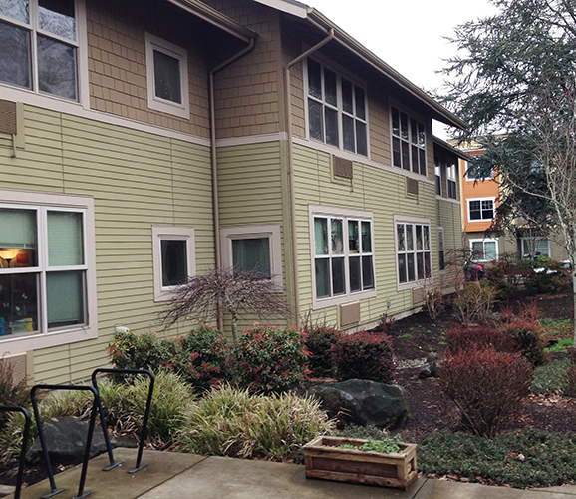
Project Design
We will meet the needs of our tenants by having all needed resources available to our tenants in the building.
Notes:
How will you meet the needs of your tenants via the project design?
Any special design features?
Pictures, drawings of units, building?

Slide 9

Development Timeline
Our shelter will be available by fall of 2022
We will begin building on our affordable housing units by end of summer 2022
We will have staff ready and available for our shelter and our affordable housing by the end of fall 2022.
We have begun several grant processes and sent out need for donations letter to several funders at this time.
Our project developer has looked at several sites and we are also looking at renovating an old building.
Notes:
Optional Budget information: services, capital, operating (can be separate slides, if needed)-- especially if have funding gaps
Acquisition Strategy: [Example: Partnership with Land bank – X number of lots secured/pending contract/site working on selecting good sites]

Slide 10
Lesson Learned and Next Steps
The institute has brought us closer to the actualization of this project. By teaching us the steps to take they have saved us time in making mistakes and what to do first. We are putting a preliminary budget together to source funding. Homelessness in this region is tantamount to another epidemic.
Next steps are that we are going to funders, we are getting the funding going so that we have a budget to start the process with. The Spring 2022 Cohort of Washington Supportive Housing Institute have been very informative, it’s time to convert the training to actionable items targeted at achieving the team goal- To see our participants move to our affordable housing
We have also set ourselves up with a few companies that are all about us getting up and going and they are on board to help us work out any hiccups we may come across. My team has been volunteering hours to support this effort. Availability of funding would help to take the efforts to the next level-from vision to conceptual stage to actual design and construction.
Everyone needs a second chance, serving the targeted population is not only the right thing to do, it is Humane. We are looking for funders to build this company into the resource that we want it to be.
Notes:
Lesson Learned:​
What have you changed since the institute? Did it impact your project design or approach?
Next Steps
Do you have an ask for funders?
Funding gap/need?
Other needs?

Slide 11
Thank You

